Slide 1

ENHANCING HOST STRATEGY USING DATA ANALYSIS
ON AIRBNB
By : Amith Joseph

Slide 2
PROJECT OBJECTIVES
1
Assess Airbnb hosting strategies across diverse locations through data analysis
2
Uncover patterns in listing prices, occupancy rate, and the influence of amenities on revenue
3
Evaluate seasonality, local events, and neighborhood effects on demand and profitability
4
Equip Airbnb hosts with actionable strategies for optimizing pricing, maximizing occupancy, and enhancing guest experience
5
Offer data-driven guidance to investors on identifying high-demand neighborhoods for profitable investments

Slide 3


DATASET OVERVIEW
DATA SOURCE
Airbnb Open Data Inside Airbnb
https://insideairbnb.com/get-the-data
/
San Diego
CITY
San Diego, California, USA
DATASETS
Listings
Calendar
Reviews

Slide 4
DATASETS
LISTINGS
Contains detailed data on individual Airbnb listings
CALENDAR
Provides daily availability and pricing information for each listing over a specified period
REVIEWS
Includes reviews for each listing, detailing the date and
reviewer informatio n
●
●
●
Including attributes like price, number of bedrooms, and amenities

Slide 5
LIBRARIES
01
folium
folium.plugins.MarkerClus A plugin in Folium _{t}f_{e}o_{r}r clustering map markers based on
proximity
datetime
A module for handling date and time in
Python
02
A library for creating interactive maps using Python
wordcloud
A library for creating word cloud visualizations from text data
matplotlib.pyplot A plotting library for creating static, animated, and interactive visualizations in Python
03
04
sklearn.feature_extraction.t ext.CountVectorizer
A module in scikit-learn for converting a collection of text documents to a matrix
of token counts
05
06

Slide 6
CODE DEMONSTRATION

Slide 7
KEY INSIGHTS

Slide 8
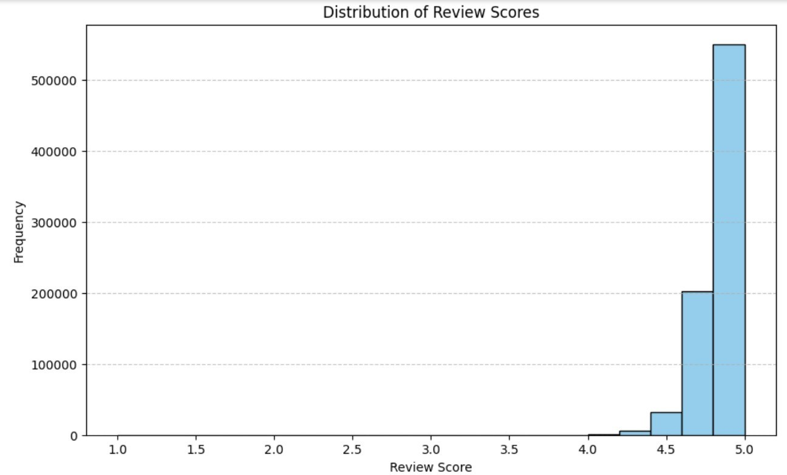
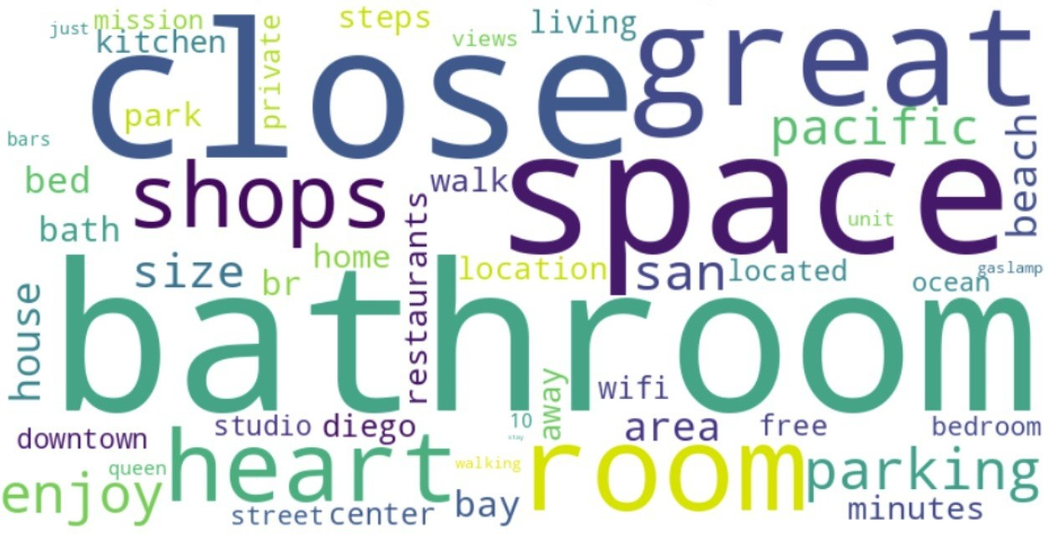
KEYWORD ASSOCIATION WITH REVIEW SCORES AND POPULARITY
Q1

Slide 9
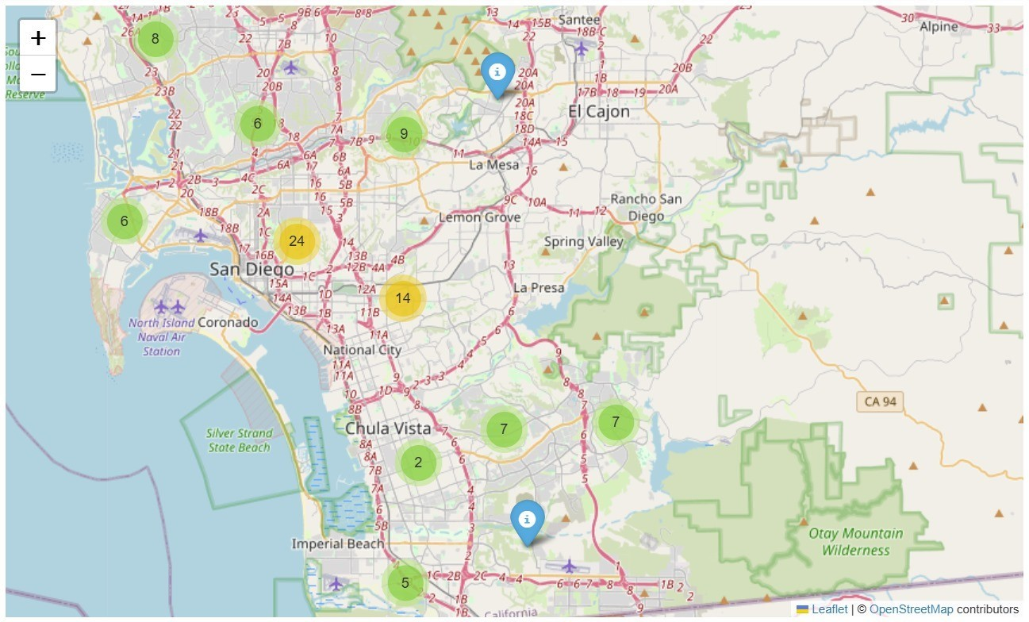
NEIGHBORHOOD INFLUENCE ON PRICES AND AVAILABILITY
Q2

Slide 10
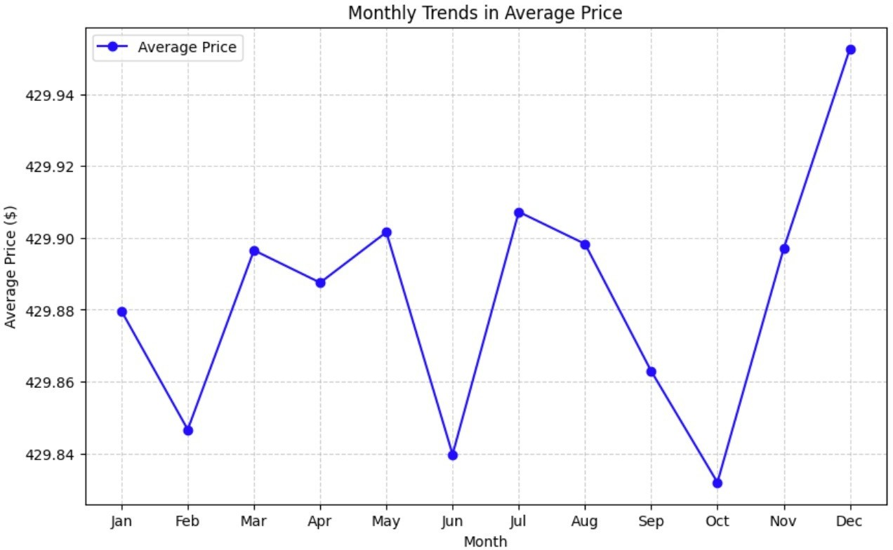
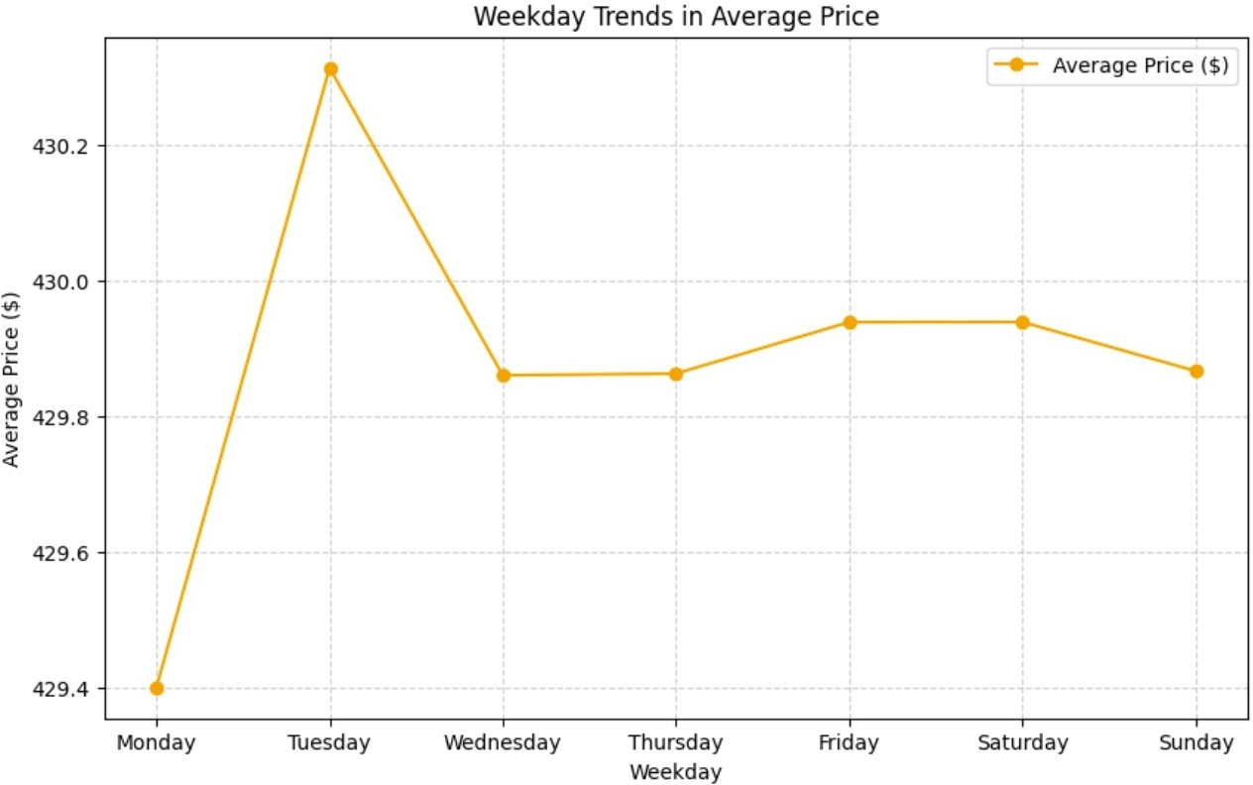
Q3
SEASONAL FLUCTUATIONS IN LISTING PRICES

Slide 11
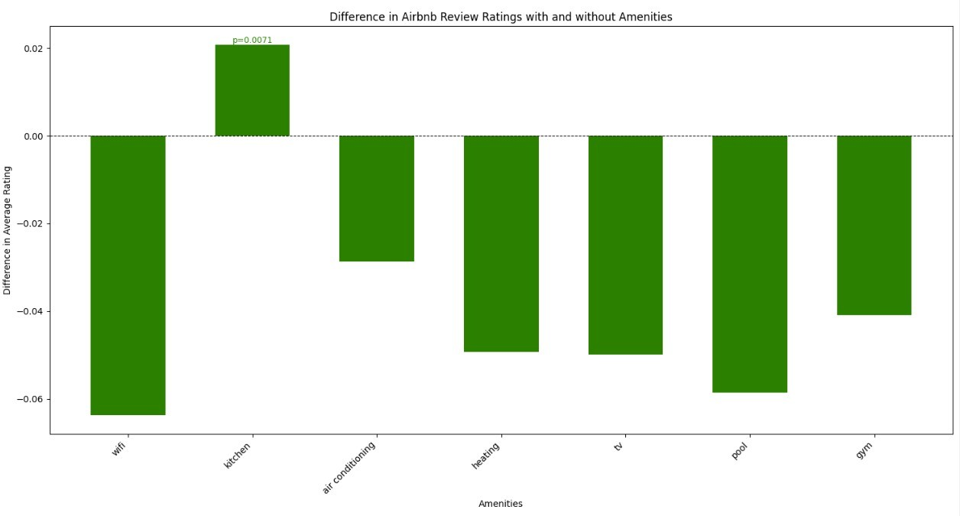
Q4
EFFECT OF AMENITIES ON AVERAGE RATINGS

Slide 12


IMPACT OF LOCAL HOSTS ON BOOKING RATES AND REVIEW SCORES
Q5

Slide 13
CONCLUSION
•
Optimized Hosting Strategies: Data insights help hosts enhance guest experiences and maximize revenue.
•
Actionable Investment Guidance: Identified high-demand neighborhoods and key profitability factors for investors.
•
Focus on Key Factors: Analyzed pricing, occupancy, amenities, seasonality, and neighborhood dynamics.
•
Competitive Edge: Equipped stakeholders with strategies to thrive in the dynamic short-term rental market.
Significance of Data-Driven Decisions: Demonstrated the critical role of analytics in fostering success and superior guest experiences.

Slide 14
THANK YOU

